Slide 1
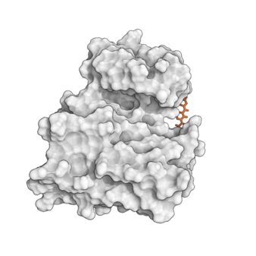
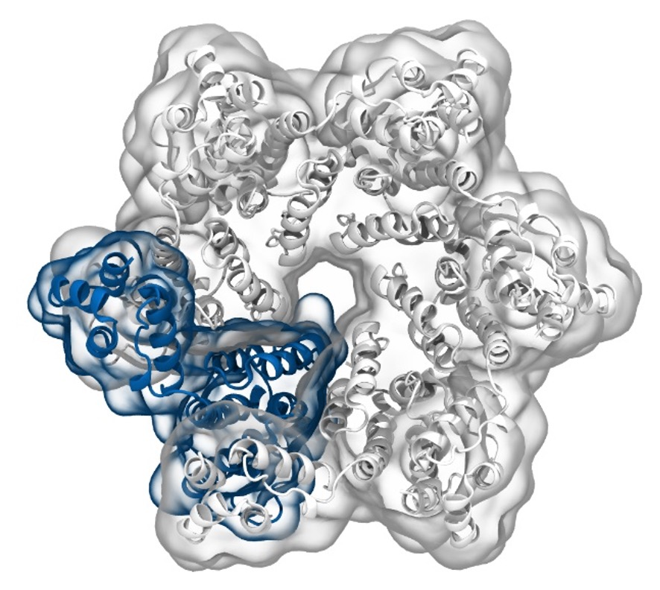
Simulation of Biomolecules
Setting up a protein
simulation
2024 CCP5 Summer School
Dr Matteo Degiacomi
Durham University
matteo.t.degiacomi@durham.ac.uk
Dr Antonia Mey
University of Edinburgh
antonia.mey@ed.ac.uk

Slide 2
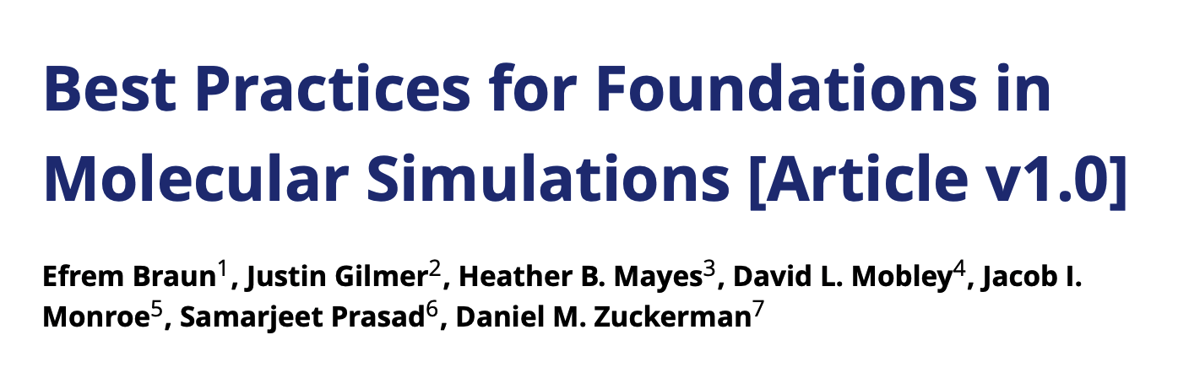
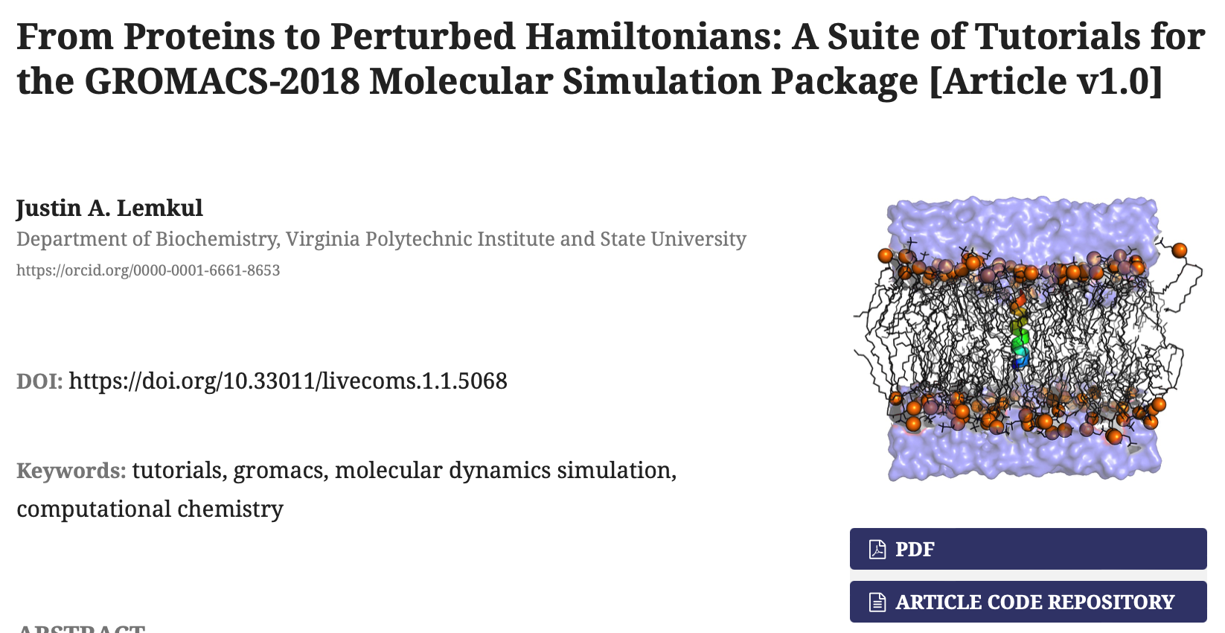
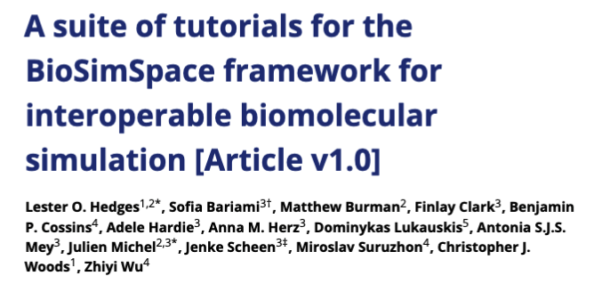

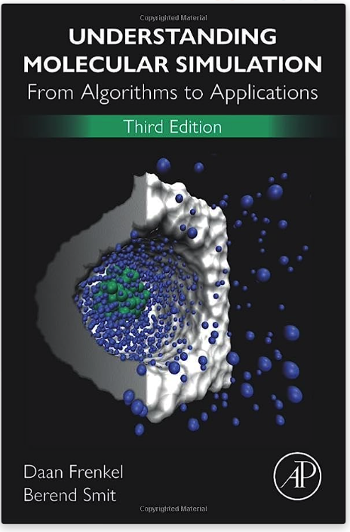
Useful resources to learn running simulations
GROMACS: tutorials.gromacs.org
Amber: ambermd.org/tutorials
OpenMM: docs.openmm.org/latest/userguide/library/03_tutorials.html

Slide 3
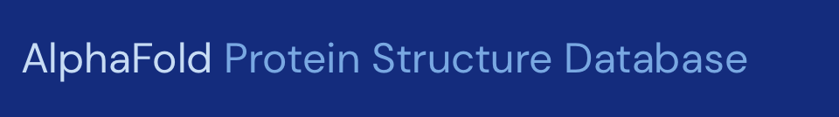
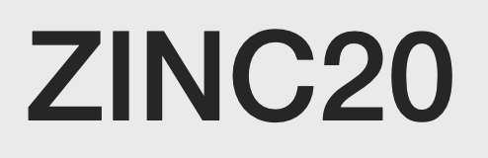
A typical workflow for molecular dynamics
Get protein structure
Getting your protein structure
Prep for simulation
Simulation setup
Getting ligands/co-factors
Run Simulation Protocol
Simulation Analysis

Slide 4


A typical workflow for molecular dynamics
Get protein structure
Prepping your protein and/or ligand(s)
Prep for simulation
Simulation setup
Run Simulation Protocol
Simulation Analysis
[…]

Slide 5
A typical workflow for molecular dynamics
Get protein structure
Setup and run on your favourite MD engine
Prep for simulation
Gromacs
OpenMM
Simulation setup
Amber
NAMD
BioSimSpace
SOMD
Run Simulation Protocol
Charmm
DLPoly
LAMMPS
mostly C++
command line
Simulation Analysis
Python API

Slide 6
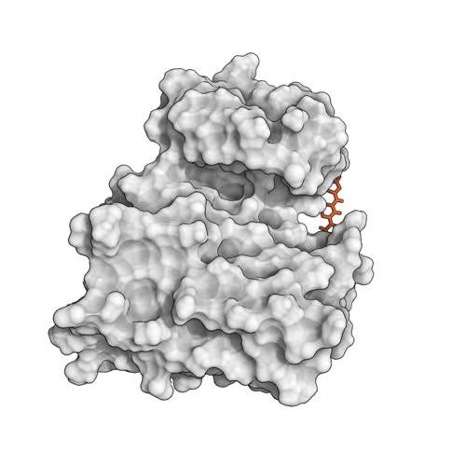


Disclaimer!
Running biomolecular MD can take days on specialised hardware.
Today we will not run any of them, and instead will focus on fundamental principles.

Slide 7
A Molecular Dynamics timestep
Set initial conditions for x, v and box size
Compute forces
Compute new x and v for all atoms
Apply restraints to bonds
Scale x and v with thermo/barostat
Update x and v (with boundary conditions)

Slide 8
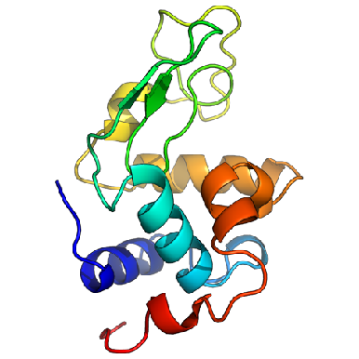
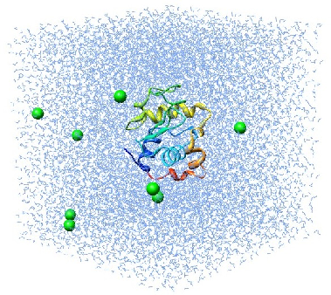
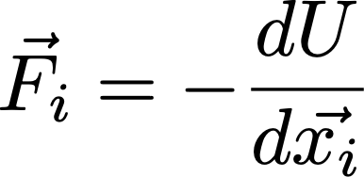
Molecular dynamics require multiple steps for the setup of simulations
Disulphide bridges
Protonation
Solvate in water and add ions
Crystal Waters
Cofactors
Alternative side chains
Solvated protein
Apply forcefield description
NVT/NPT equilibration
Minimize the positions
Equilibrated system
Solvated protein + forcefield
minimized protein
Production simulation
http://www.bevanlab.biochem.vt.edu/Pages/Personal/justin/gmx-tutorials/lysozyme/01_pdb2gmx.html
Levitt, Nature Structural Biology, 8, 392–393(2001)

Slide 9

There are many different choices for force fields to be made
Small molecule force fields
GAFF
Machine learned force fields
Amber (Peter Kollmann, UCSF) –Glycam parameters cover most sugars (Robert J. Woods, University of Georgia)
CHARMM (Martin Karplus, Harvard) –POPC, POPE, DPPC lipids
OPLS (William Jorgensen, Yale)
GROMOS (Wilfried van Gunsteren, ETHZ)
SchNet
Ani-2x
PhysNet
Espaloma
BandNN
There is no “best force field”!
Coarse-grained force fields…

Slide 10
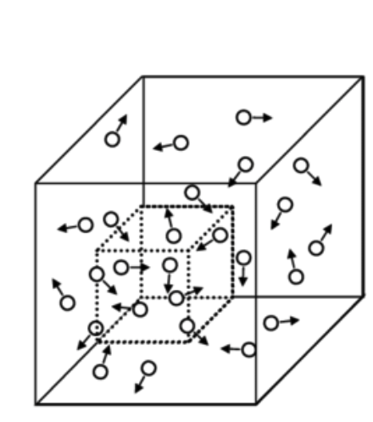
Choosing your thermodynamic ensemble
Simulations replicate a specific thermodynamic ensemble (typically NVT or NPT), or even grand canonical (μVT)
You will have different options to include thermostats (scaling atom velocities) and barostats (scaling positions) in your calculations:
Nose-Hoover
Berendsen
Parrinello-Rahman
Langevin piston
…
μVT
NVT/NPT equilibration
Minimize the positions
Equilibrated system
Solvated protein + forcefield
minimized protein

Slide 11
Periodic boundary conditions (PBC) and pressure coupling
…
…
…
…
If you want to simulate membrane systems, you want to chose semi-isotropic pressure coupling!
Typically, PBC in x-y-z

Slide 12
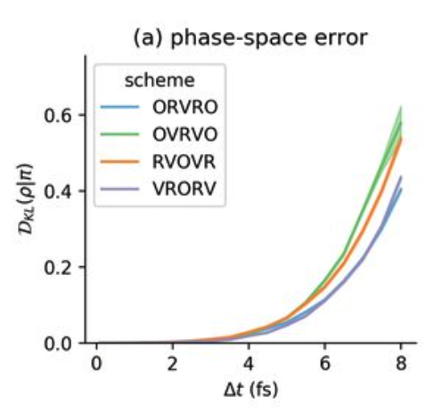
Sampling timescales for protein systems
The steepest gradient determines the smallest timestep:
Timestep size is imposed by the fastest phenomenon we want to observe :
Covalent bond hydrogen-heavy atom (10¹⁴ Hz): 0.5 fs
Covalent bond heavy atom-heavy atom: 1 fs
Angles fluctuations: 2 fs
Restraining covalent bond distances allows to use 1-2 fs timesteps (restraining methods: SHAKE, RATTLE, LINCS,…)
Hydrogen Mass repartitioning: 4 fs
Other integrators (e.g., Langevin): 4 fs - 6 fs.

Slide 13
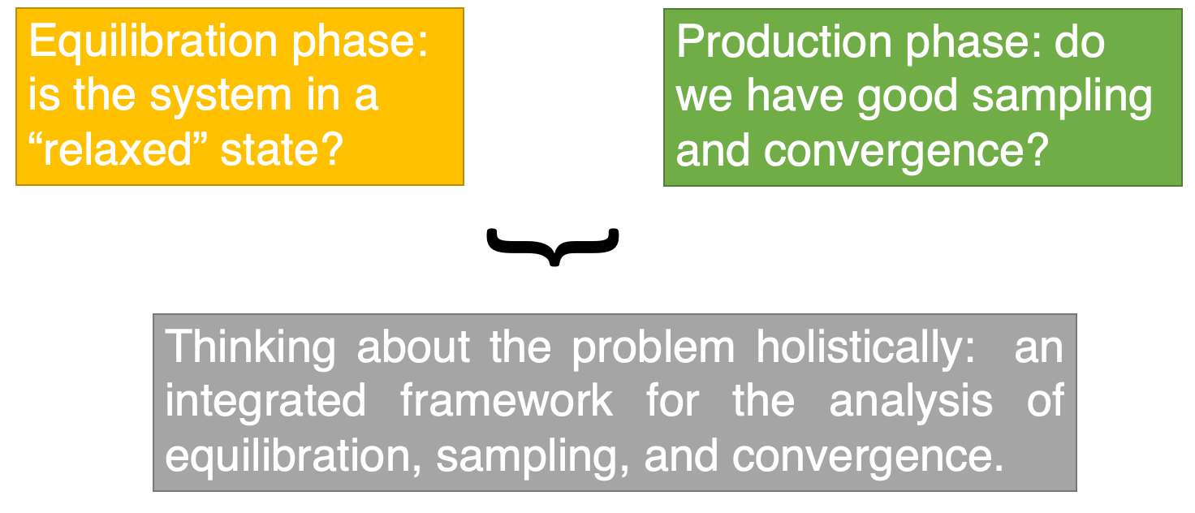
“equilibration” and “convergence”, what do they mean?

Slide 14
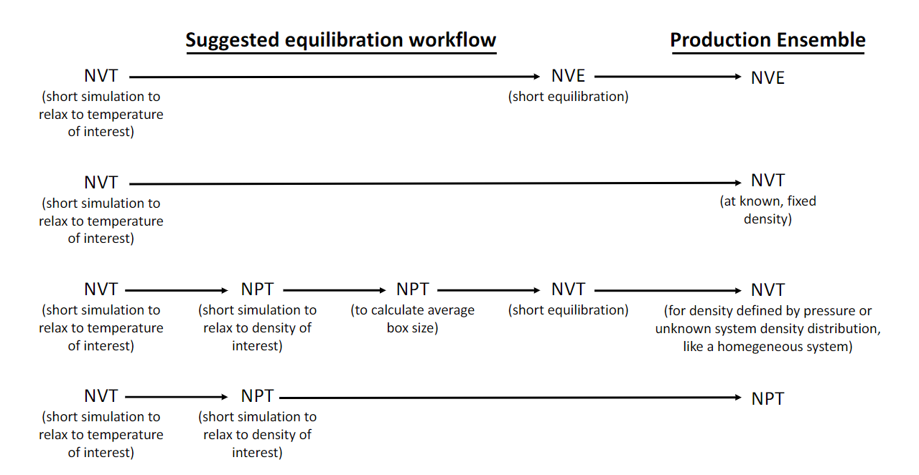
Example equilibration protocols
YOU WANT: constant volume, pressure, and temperature, healthy Ramachandran plot, no exotic chemistry, bulk water (if used)
Living J. Comp. Mol. Sci. 2019, 1, 5957

Slide 15
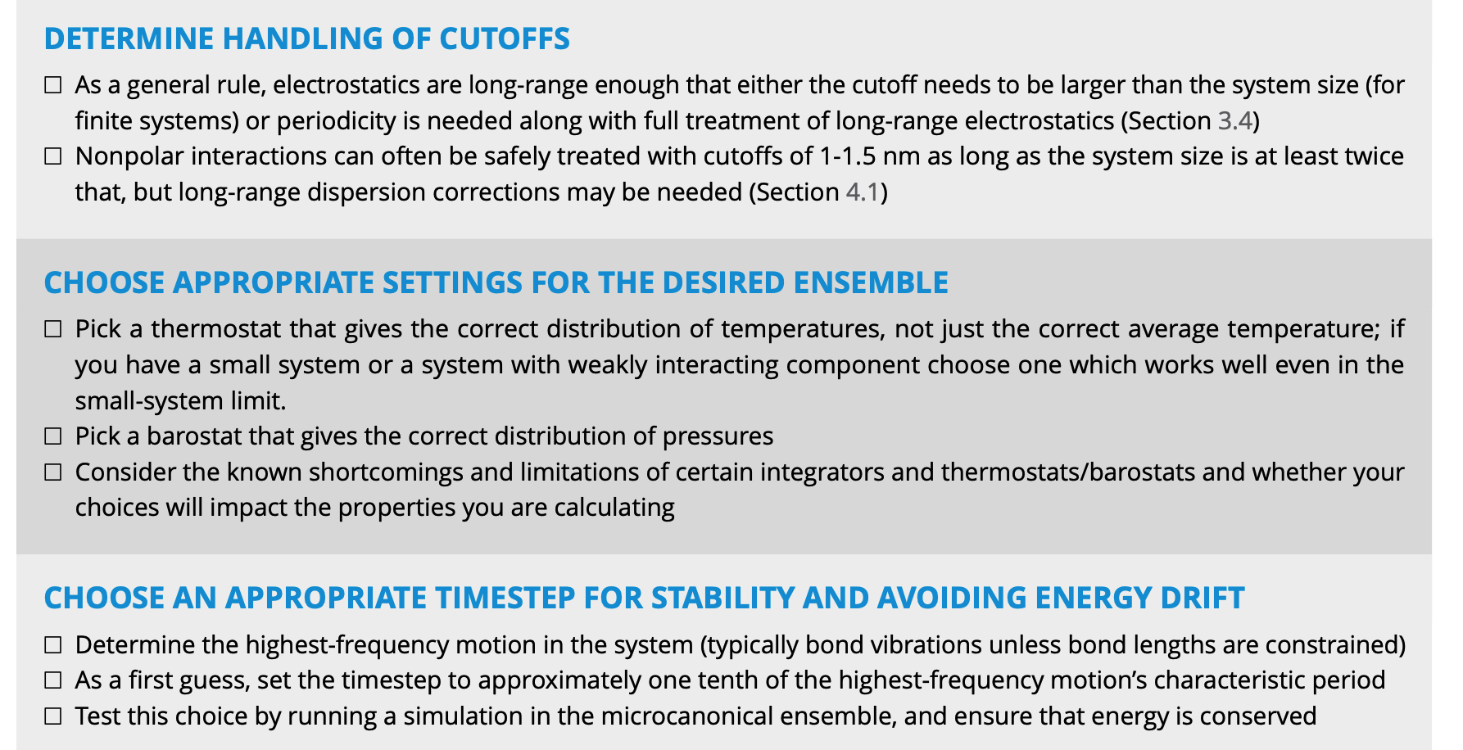
An example simulation protocol
YOU WANT: constant volume, pressure, and temperature, healthy Ramachandran plot, no exotic chemistry, bulk water (if used)
Equilibration:
Minimize energy, 1000 steepest descent
Heat system from 0 to 300 K in 500 ps, NPT, Berendsen barostat 1 atm. α-carbon restrained with 10 kcal/mol harmonic potential. 2 fs timestep, LINCS all bonds
1 ns nVT equilibration with Langevin dynamics, no atom constrained.
Production:
4. 1 µs NPT, Nose-Hoover barostat, PME for
electrostatics
Living J. Comp. Mol. Sci. 2019, 1, 5957

Slide 16
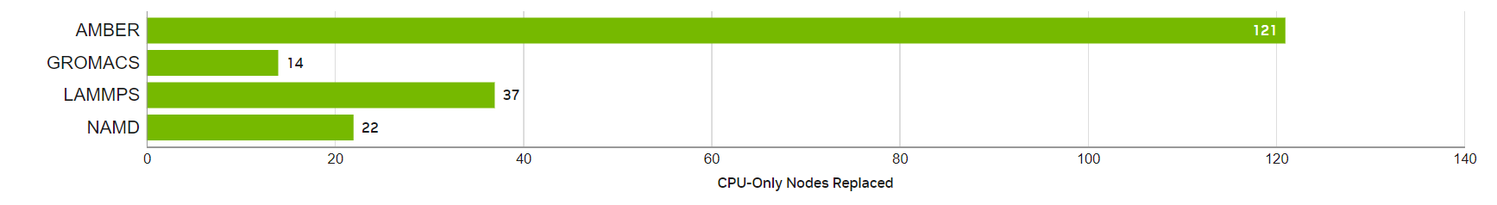
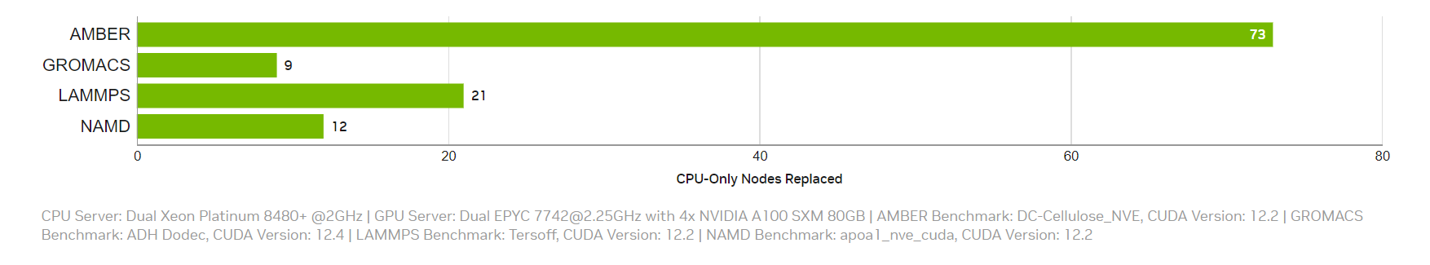
Which MD engine should I use?
Consider:
Support for force field of choice
Enables running desired simulation protocol
Performance for available hardware
Ease of use
depends on number of atoms, hardware, simulation protocol,
MD engine
Graphical Processing Units (GPUs) are especially effective for MD
From: developer.nvidia.com/hpc-application-performance
NVIDIA H200
NVIDIA A100

Slide 17
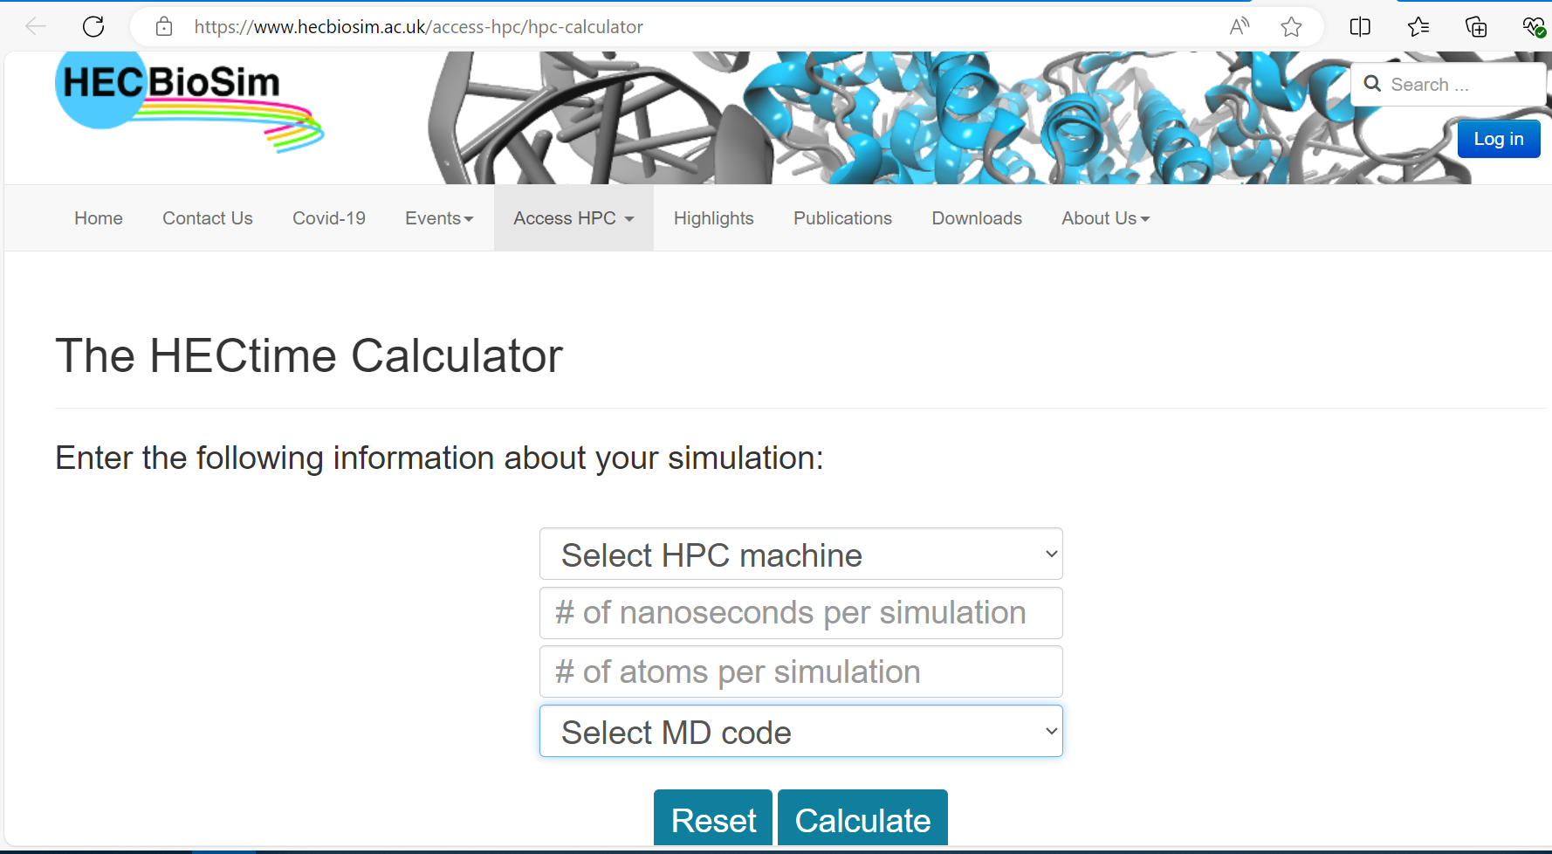
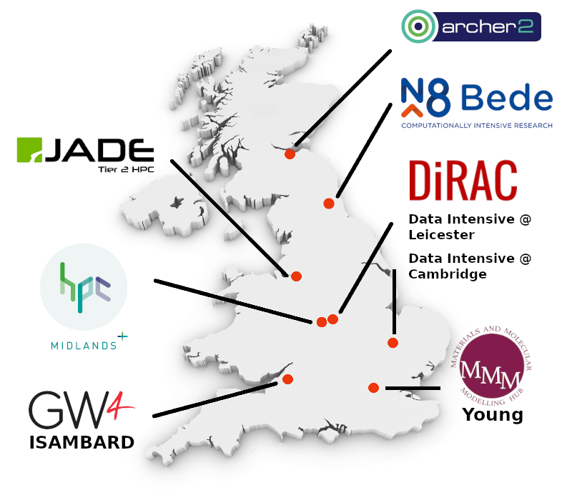
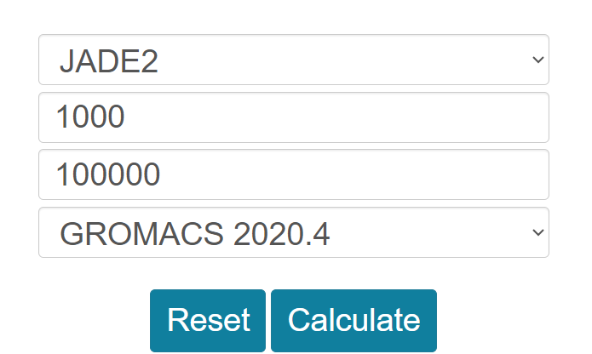
Calculating runtimes: example on UK Tier 2 systems
https://www.hecbiosim.ac.uk/access-hpc/hpc-calculator

Slide 18
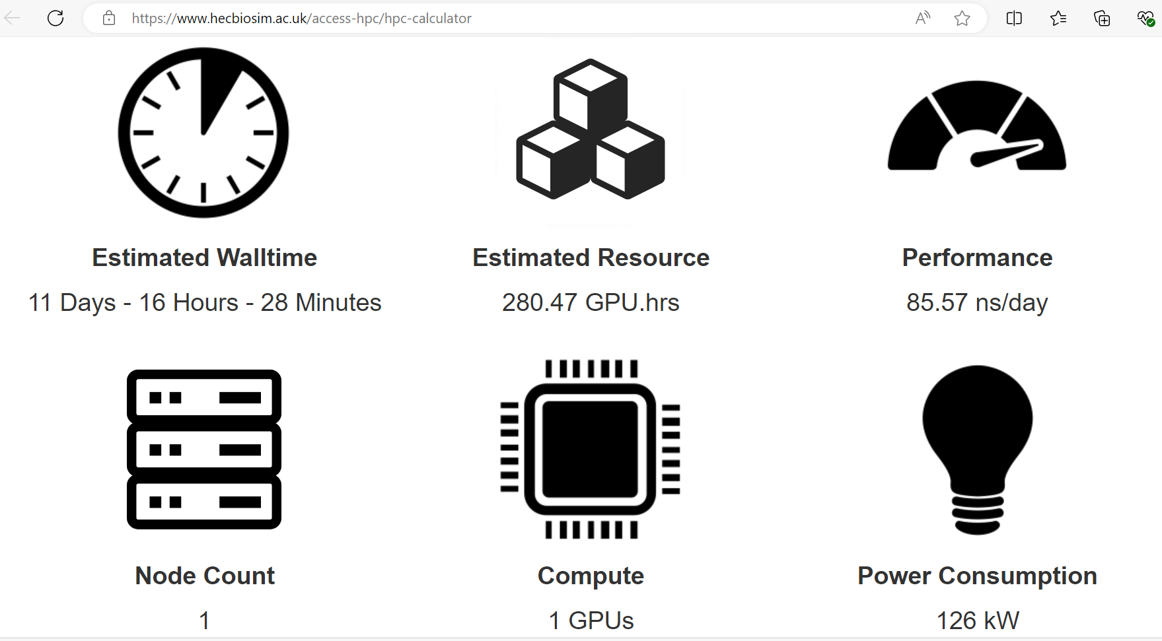
Calculating runtimes: example on UK Tier 2 systems
https://www.hecbiosim.ac.uk/access-hpc/hpc-calculator

Slide 19

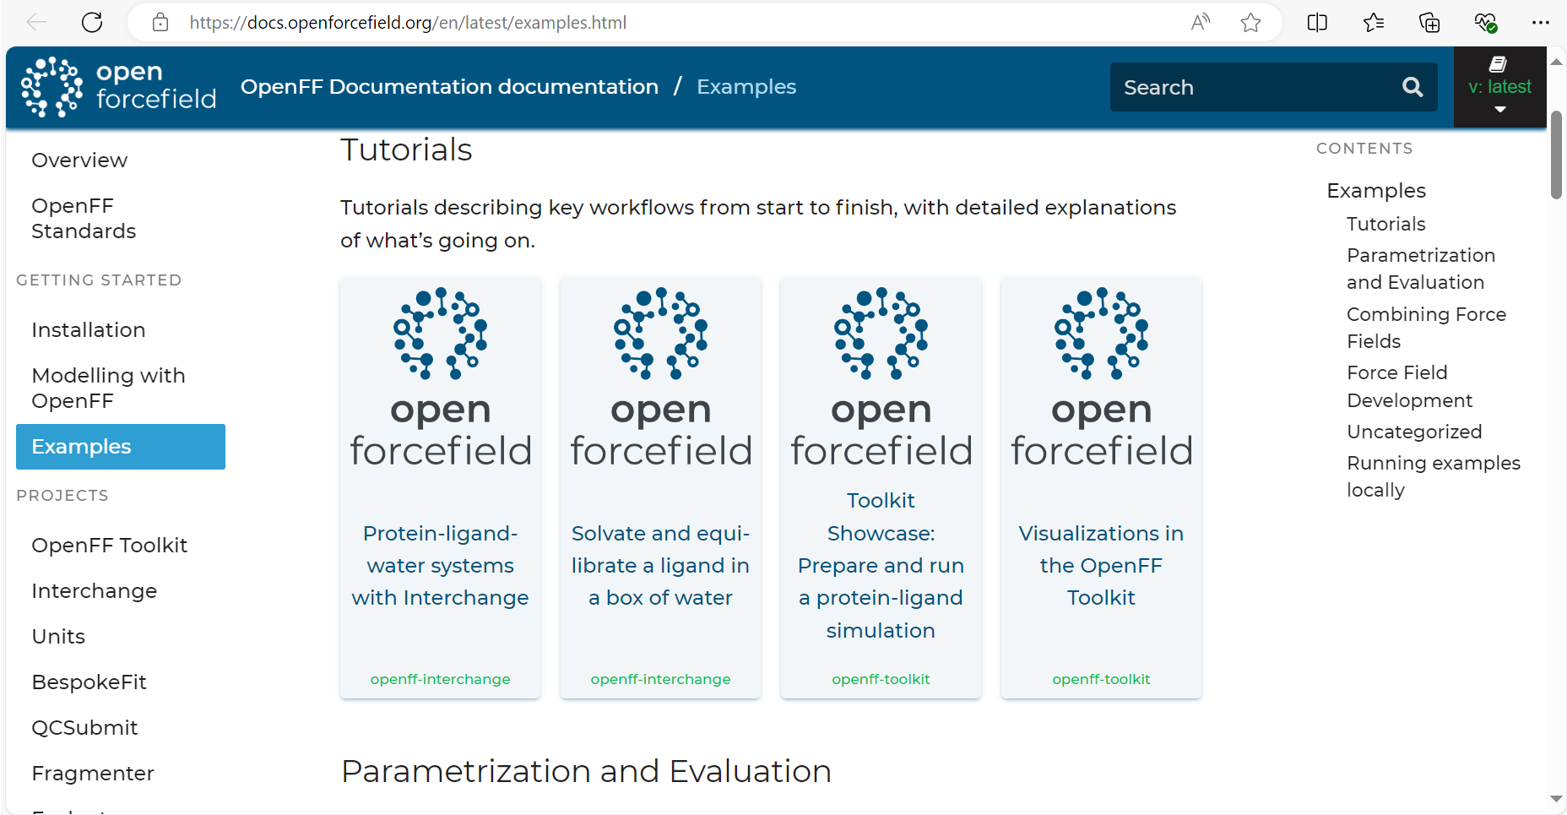
https://docs.openforcefield.org/en/latest/examples.html

Slide 20
